Slide 1
Post-Quantum Cryptographic Hardware Primitives on FPGAs - based on Ring-Learning with Errors (R-LWE)
Rashmi Agrawal
ASCS Lab

Slide 2
Acknowledgement
Alan
Area saving suggestions
LUT- vs BRAM-based implementations
Notes:
Thanks to Alan for being our design guide. He suggestions on area saving implementations and LUT vs BRAM-based implementations were really helpful.

Slide 3
Presentation Flow
Motivation: why quantum-proof?
NIST: steps towards standardization
Design Workflow
State of the Art: main algorithm
What We Are Working On: tool-kit
Notes:
I will walk you through the needs of having quantum-proof, updates on the standardization process, our design workflow, then we will understand the main algorithm and then take a look at the tool-kit that we are building.

Slide 4
Presentation Flow
Motivation: why quantum-proof?
NIST: steps towards standardization
Design Workflow
State of the Art: main algorithm
What we are working on: tool-kit

Slide 5
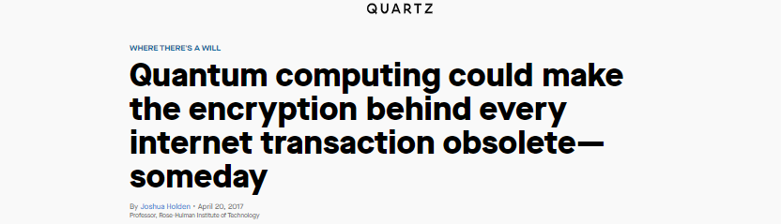
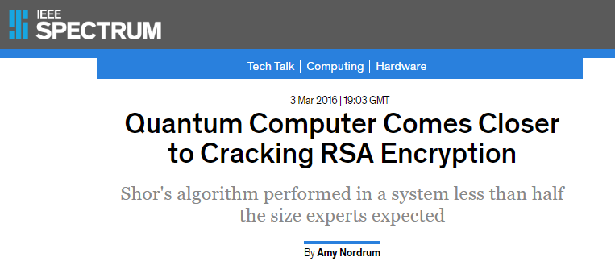
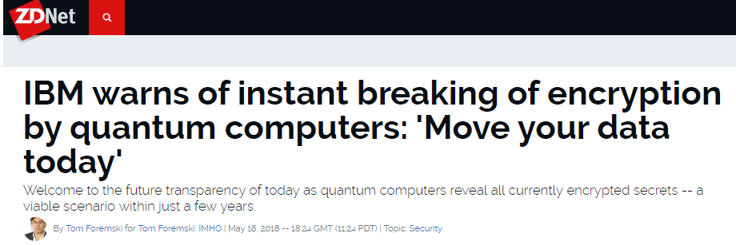
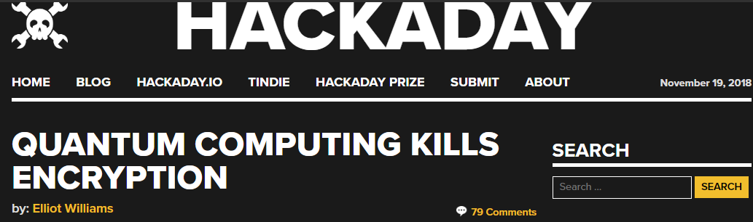
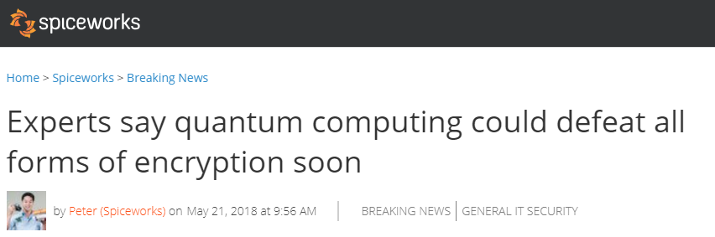
1. What Some Have Said About Quantum Computers

Slide 6

1. What Some Have Said About Quantum Computers
Quantum
Computer
Encryption

Slide 7
2. The Actual Situation Now
Who is considered as non-post-quantum secure?
Algorithm | Secure in Post-quantum Era?
RSA-1024, -2048, -4096 | No
Elliptic Curve Crypto (ECC)-256, -521 | No
Diffie-Hellman | No
ECC Diffie-Hellman | No
AES-128, -192 | No

Slide 8
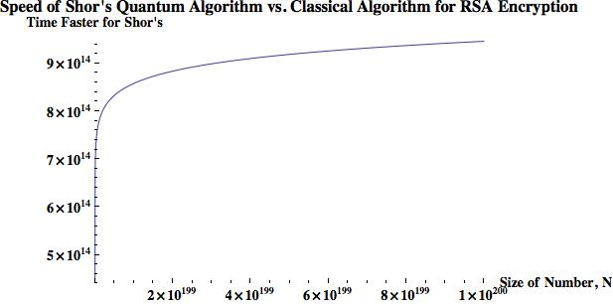
2. The Actual Situation Now
Who is considered as non-post-quantum secure?
*
To break a 768-bit (232 digits) RSA:
2 years for a current super computer
1 nanosecond for a quantum computer
(log N)²(log(log (N))(log(log(log(N)))
N: key size in decimal digits
* Zak Burkley, The Teachings of a Quantum Cat, 2016

Slide 9
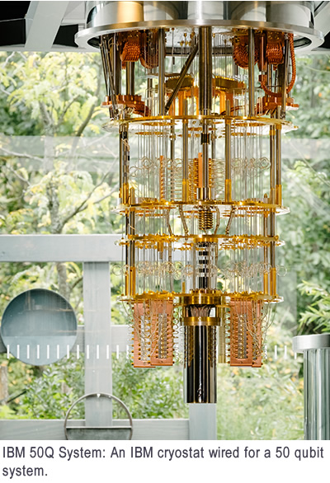
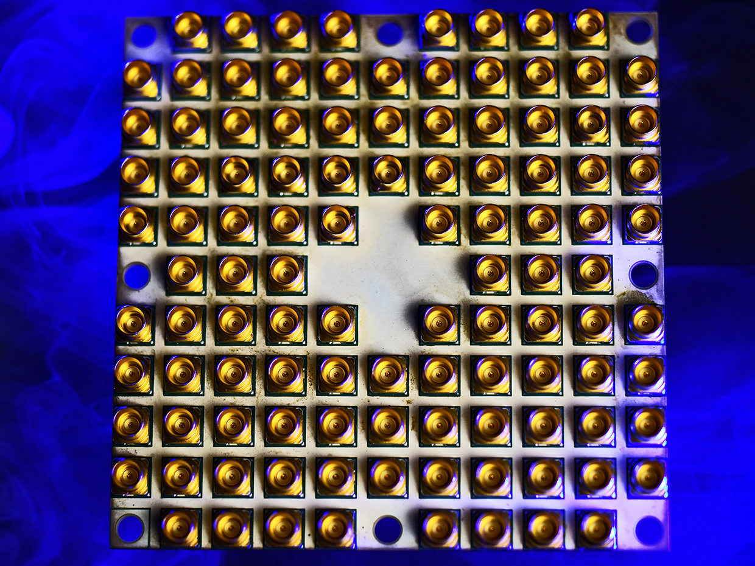
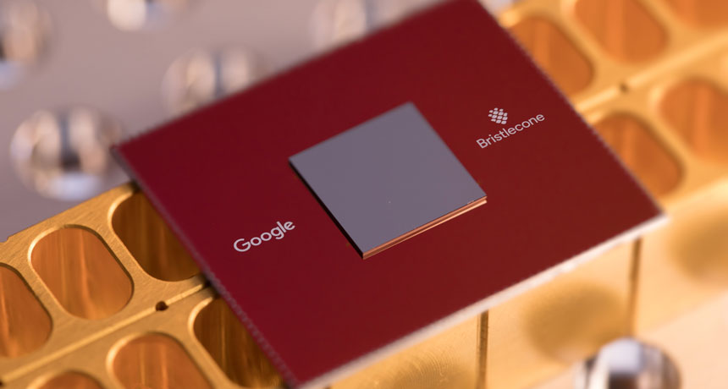
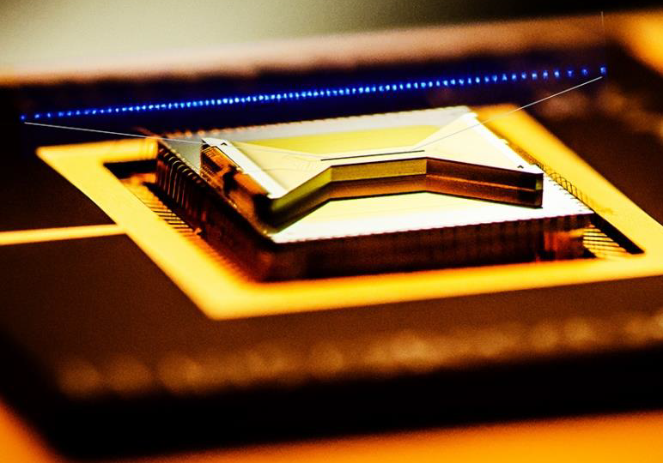
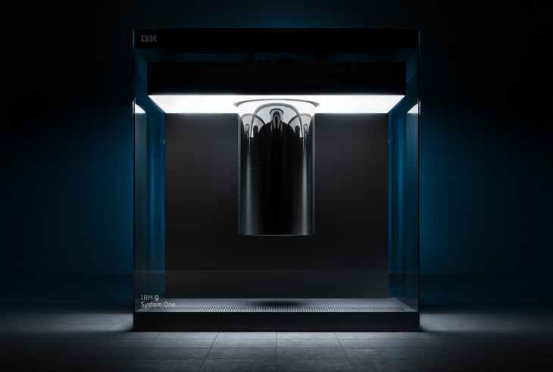
Ongoing Development
Intel 49 Qubits
Google 72 Qubits
IBM 50 Qubits, 20 Qubits
IonQ 160 Qubits
Notes:
This slide shows the ongoing development in the field of Quantum Computers.
Qubits mentioned here are Physical qubits & actual useful qubits or the logical qubits may be just ½ or 2/3 of the physical qubits. Typically many physical qubits get used up to provide stability, error-correction and fault tolerance needed to perform useful computations

Slide 10
When Quantum Computers Come …
Who is NOT considered as post-quantum secure?
Algorithm | Secure in Post-quantum Era?
RSA-1024, -2048, -4096 | No
Elliptic Curve Crypto (ECC)-256, -521 | No
Diffie-Hellman | No
ECC Diffie-Hellman | No
AES-128, -192 | No
[1]
[1] https://www.nist.gov/
Notes:
NIST published an interesting survey which shows that when quantum computers get commercialized most of the classical cryptographic algorithms for symmetric key exchange will not be secure and none of the Public key algorithms will be secure. With quantum supremacy even the 4096 bit RSA algorithm will not be secure.

Slide 11
Question
Can we increase the key size of some popular encryption schemes, so that they can be post-quantum secure?
Maybe yes, maybe no.
Table II. Equivalent Security Levels of AES and RSA under Attacks from Classic and Quantum Computers *
Attack Platform | Symmetric Encryption |  |  | Asymmetric (Public-key) Encryption
 | Algorithm | Key Size | Security Level | Algorithm | Key Size | Security Level
Classic Computers | AES-128 | 128 | 128 | RSA-2048 | 2,048 | 112
 | AES-256 | 256 | 256 | RSA-15360 | 15,360 | 256
Quantum Computers | AES-128 | 128 | 64 | RSA-2048 | 2,048 | 25
 | AES-256 | 256 | 128 | RSA-15360 | 15,360 | 31
*
Grover’s algorithm
Shor’s algorithm
* TechBeacon, Waiting for quantum computing: Why encryption has nothing to worry about, 2018
Notes:
An interesting question to ask ourselves is
As prescribed by NIST, 112 bits is the minimum security level required. Grover’s algorithm operates using Brute force search approach and that reduces the key search space to its square root (2^128 reduced to 2^64). Shor’s algorithm is quantum Fourier transform which reduces the key space to 2^25 & 2^31. What remains to use is large AES and large Hash which gives us at least 128 bit security which is barely enough.

Slide 12
How Pressing is the Issue?
Current Situation of Quantum Computers
2011: 14 calcium ion qubits
2017: IBM 50-qubit quantum computer
2018: Google 72-qubit quantum computer
2018: 16 superconducting qubits
2018: 18 fully entangled photon qubits
2019: IBM Q-system 20-qubit commercialized
Major Things that Need to Be Done
Increasing the size (# of qubits)
Error correction (need even more # of qubits)
Computation verification (of its correctness)
Quantum Supremacy: 49 qubits, and a two-qubit error below 0.5% *
* Google Quantum AI Lab: A Preview of Bristlecone, Google’s New Quantum Processor, 2018
Notes:
We know that IBM has already launched first commercial quantum computer with 20 qubits. What we are going to experience soon is the quantum supremacy i.e. quantum computers with large number of qubits with qubit error below 0.5%

Slide 13
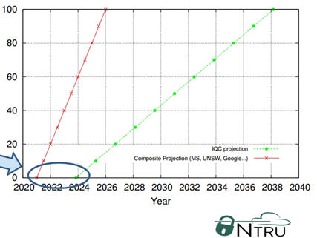
How Far Is It From Us?
The Projected Timeline of General Quantum Computers
Early 2015 Projection
Late 2015 Projection
Threat Window
(1 ~ 5 yr)
[1]
[1] Lee Wilson, The Rise of Quantum Computers – The Current State of Cryptographic Affairs, 2016
Notes:
And how far are we from seeing the quantum supremacy? NTRU published a good insight on this. Early 2015 they projected a timeline that commercial qc will be first available in 2024 and readily available by 2038. But developments in the field made them do second projection in late 2015 saying that commercial qc will be available in 2021 and readily available by 2026. which reduced the window by 5 years. Moreover we know that IBM launched first qc in 2019 which further narrows down the gap.

Slide 14
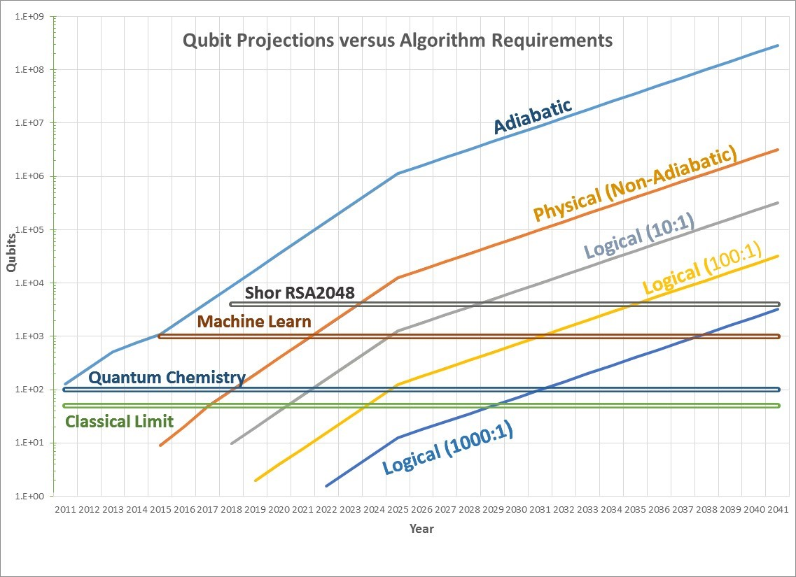
Applying Moore’s Law to Quantum Computers
(1 ~ 5 yr)
[1]
2023
2028
[1] https://quantumcomputingreport.com/our-take/applying-moores-law-to-quantum-qubits/
Notes:
Researchers also started applying Moore’s law to QC and by the past experience from 2011 they found that Moore’s law fits pretty well to QC and they can do reasonable predictions for future. By this prediction RSA will be broken between the year 2023 and 2028 which matches the prediction on the previous slide which is 2026.

Slide 15
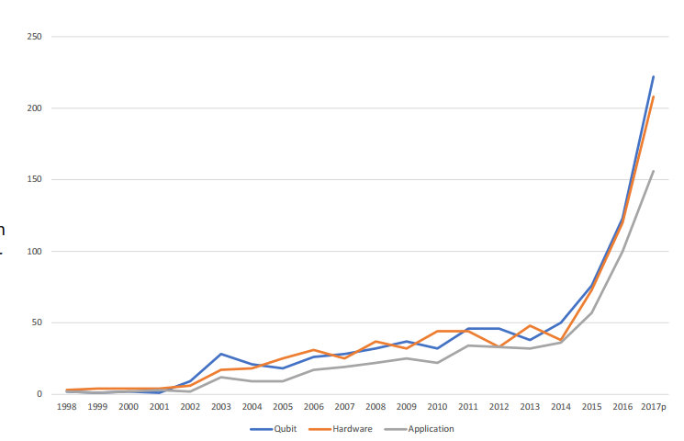
Quantum Computing Patents by Year
[1]
[1] http://www.ipwatchdog.com/2017/12/04/u-s-leads-world-quantum-computing-patent-ibm/id=90304/
Notes:
It might even speed up. Look at the trends of patents.

Slide 16

Quantum Computer-based Cryptography vs General Computer-based Quantum-proof Cryptography
Notes:
Having to develop quantum computer-based cryptography is rich man’s solution like Iron man & batman. Developing conventional computer based quantum proof solutions is a common man’s approach like spiderman.

Slide 17


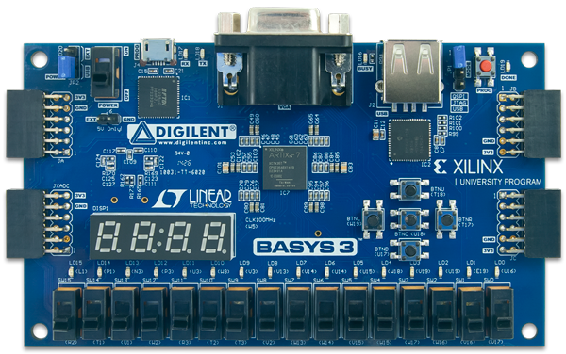
Quantum Computer-based Cryptography vs General Computer-based Quantum-proof Cryptography
Notes:
As soon as one powerful QC can be built by IBM or Google or Intel, all conventional cryptosystems will not be secure. Meaning we can’t publish any papers based on conventional secure schemes. But still it will take at least a decade for everyone to move to quantum computer-based defenses. So, we would envision that, for 5-10 years, silicon based Quantum-Proof solutions such as FPGA will still be mainstream for researchers, banks and various govt. agencies. Another advantage is that what ever Quantum-proof is getting implemented now on FPGA, can still be implemented on Quantum Computers. So, we are building a solution for now and for tomorrow.

Slide 18
Presentation Flow
Motivation: why quantum-proof?
NIST: steps towards standardization
Design Workflow
State of the Art: main algorithm
What we are working on: tool-kit
Notes:
Let’s now see how is NIST doing in standardizing Post-Quantum Crypto

Slide 19
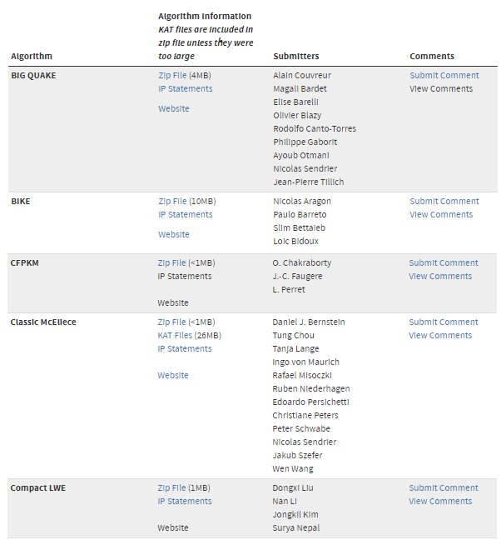
Post-Quantum Cryptography (PQC) Standardization (Round -1)
NIST
Jan 2017 – Dec 2018
Evaluating 69 (5 withdrawn) submissions of PQC, to bring up a standard (just like AES or RSA):
21 lattice-based
18 code-based
Some hash-based
Some others
[1]
Submission deadline Nov 30, 2017. List updated Dec 20, 2018.
[1] https://csrc.nist.gov/projects/post-quantum-cryptography/round-1-submissions
Notes:
First round ran from Jan 2017 to Dec 2018 and some 69 submissions happened. Out of these submissions, 21 were lattice-based, 18 were code-based, some hash-based for digital signatures and few others.

Slide 20

Post-Quantum Cryptography (PQC) Standardization (Round -1)
NIST
Jan 2017 – Dec 2018
Evaluating 69 (5 withdrawn) submissions of PQC, to bring up a standard (just like AES or RSA):
21 lattice-based
18 code-based
Some hash-based
Some others
[1]
Ring-Learning with Error (Ring-LWE)
Submission deadline Nov 30, 2017. List updated Dec 20, 2018.
[1] https://csrc.nist.gov/projects/post-quantum-cryptography/round-1-submissions
Notes:
So what clearly stood out was lattice-based crypto. And that too Ring-Learning with Error.

Slide 21

Why Learning with Error (LWE)?
a
s
e
b
2
13
7
3
s1
e1
13
4
7
9
1
s2
e2
12
*
+
=
6
14
5
11
s3
e3
3
5
11
13
2
s4
e3
9
An arbitrary number of equations, each distorted up to $±\text{α}\text{q}$,
How to find s?
(2s1 + 13s2 + 7s3 + 3s4) + e1 = 13 (mod q)
(4s1 + 7s2 + 9s3 + 1s4) + e2 = 12 (mod q)
(6s1 + 14s2 + 5s3 + 11s4) + e3 = 3 (mod q)
(5s1 + 11s2 + 13s3 + 2s4) + e4 = 9 (mod q)
Notes:
This is because Learning with Error is considered hard to break because of the small error. Say a and b are public key and we need to extract s the secret key. To extract secret key using a and b, as you can see, the operations get converted into an arbitrary number of equations where each equation is distorted by an error rate +-alpha q.

Slide 22
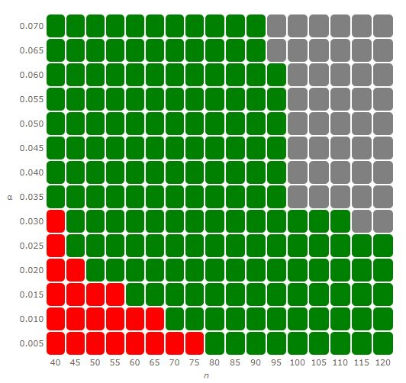
Why Learning with Error (LWE)?
[1]
α
We are building with n = 256, 512
n
75
[1] https://www.latticechallenge.org/lwe_challenge/challenge.php
Notes:
This is from one of the existing challenges going on for lattice-based crypto. On x-axis you have the n values and y-axis shows the error rate. Red portions show what is already broken. Green portions show what people are trying to break and for the grey portion challenges are getting developed. So we can clearly see that n=75 is broken and it is not easy to break as the n value increases. And what we are building is a system with n = 256 and 512.

Slide 23
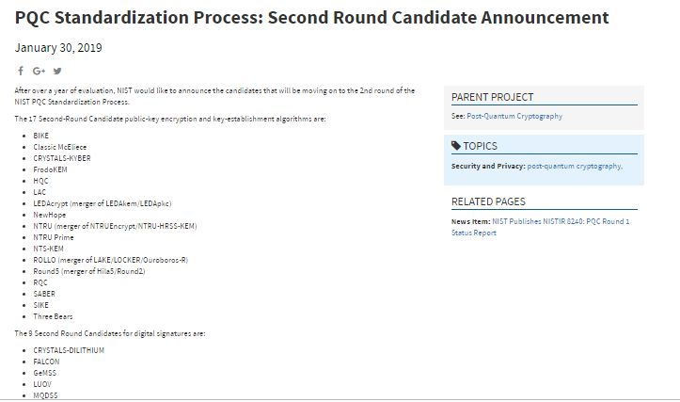
Post-Quantum Cryptography (PQC) Standardization (Round -2)
NIST
Jan 30, 2019 published candidates of Round-2:
27 submissions
Who survived?
12 lattice-based
8 code-based
some multivariate-based and hash based for digital signatures
Notes:
Having said that let’s look at the candidates of second round. On Jan 30, 2019 NIST published first round results. Out of some 69 submissions only 27 submissions were declared as the second round candidates. Who survived the battle? Lattice based, code based and few other multivariate based and some hash-based for digital signatures.

Slide 24
Post-Quantum Cryptography (PQC) Standardization (Round -2)
Sr. No. | Public-Key Encryption
 | Lattice-based/Ring-LWE |  | Code-based |  | Other
1 | NTRU Prime | (R-lattice) | Classic McEliece | (Binary Goppa)
2 | NTRU European Encryption Standard | (R-lattice) | HQC | (BCH & cyclic)
3 | LAC | (R-LWE) | RQC | (cyclic)
4 | SABER | (Mod-LWR) | LEDA | (LDPC)
5 | Round5 | (R-LWR) | ROLLO (LAKE & LOCKER) | (LRPC)
Notes:
Let’s take a closer look at the 2nd round. We have 5 candidates in Lattice-based and 5 candidates in code-based. So the competition is actually close here. But one important note here is while the RLWE algorithms may have different name, they still follow a similar scheme for encryption and decryption. We are working on designing a standard algorithm. So whoever wins, we can tweak the design accordingly and switch to new algorithm easily.

Slide 25
Post-Quantum Cryptography (PQC) Standardization (Round -2)
Sr. No. | Key Establishment/Encapsulation
 | Lattice-based/Ring-LWE |  | Code-based |  | Other
1 | NewHope | (R-LWE) | BIKE | (MDPC) | SIKE (Isogeny)
2 | NTRU European Encryption Standard | (R-lattice) | NTS-KEM | (Binary Goppa)
3 | FrodoKEM | (R-LWE) | LEDA | (LDPC)
4 | CRYSTALS-KYBER | (R-LWE) | ROLLO (LAKE & LOCKER) | (LRPC)
5 | SABER | (Mod-LWR)
6 | Three Bears | (Mod-LWE)
Notes:
For symmetric key exchange, we have 6 candidates which are lattice-based, only 4 as code-based and one other candidate.

Slide 26
Post-Quantum Cryptography (PQC) Standardization (Round -2)
Sr. No | Digital Signature
 | Lattice-based/Ring-LWE |  | Multivariate-based | Hash-based
1 | FALCON | (NTRU R-lattice) | GeMSS | Picnic
2 | qTESLA | (R-LWE) | MQDSS | SPHINCS+
3 | CRYSTALS-DILITHIUM | (R-LWE) | LUOV
4 |  |  | Rainbow
Notes:
For digital signatures, we have 3 lattice-based candidates. Code-based cannot be used for digital signatures. So no entries which are code-based and 4 candidates that are multivariate-based. And 2 are hash-based. Another thing to note here is that Multivariate-based is different from RLWE but submodules we build still can be reused for it as it involves performing polynomial operations.

Slide 27
Post-Quantum Cryptography (PQC) Standardization (Round -2)
 | Public-Key Encryption
 | Lattice-based/Ring-LWE |  | Code-based |  | Other
1 | NTRU Prime | (R-lattice) | Classic McEliece | (Binary Goppa)
2 | NTRU European Encryption Standard | (R-lattice) | HQC | (BCH & cyclic)
3 | LAC | (R-LWE) | RQC | (cyclic)
4 | SABER | (Mod-LWR) | LEDA | (LDPC)
5 | Round5 | (R-LWR) | ROLLO (LAKE & LOCKER) | (LRPC)
 | Digital Signature
 | Lattice-based/Ring-LWE
1 | FALCON | (NTRU R-lattice)
2 | qTESLA | (R-LWE)
3 | CRYSTALS-DILITHIUM | (R-LWE)
 | Key Establishment/Encapsulation
 | Lattice-based/Ring-LWE |  | Code-based |  | Other
1 | NewHope | (R-LWE) | BIKE | (MDPC) | SIKE (Isogeny)
2 | NTRU European Encryption Standard | (R-lattice) | NTS-KEM | (Binary Goppa)
3 | FrodoKEM | (R-LWE) | LEDA | (LDPC)
4 | CRYSTALS-KYBER | (R-LWE) | ROLLO (LAKE & LOCKER) | (LRPC)
5 | SABER | (Mod-LWR)
6 | Three Bears | (Mod-LWE)
Notes:
So on the whole we have enough representation in each category and it is a pretty strong candidate.

Slide 28
Why Ring-LWE?
Advantages
A branch of lattice-based cryptosystem
Able to do
Public-key encryption
Key-exchange mechanism
Digital signature
Able to build somewhat homomorphic encryption (SHE)
Used for quantum computation verification and HE[1]
Smaller key size (7k~15k bits vs. 1MB for code-based & 1TB for “post-quantum RSA”)
Simpler computation & circuits
[1] Urmila Mahadev, Classical Homomorphic Encryption for Quantum Circuits, 2018
Notes:
Lattice-based cryptosystem is based on both Shortest vector problem and the closest vector problem that are known to be NP-hard and so far there are no efficient classical or quantum algorithms to break them. Once we get the RLWE encryption co-processor with some extra efforts we can implement SHE i.e. to support homomorphic addition and multiplication. Much smaller key size in comparison to other post-quantum cryptosystems. Once implemented its hardware cost can be even less than the conventional RSA and ECC.

Slide 29

Lattice-based (Ring-LWE)
Most Likely
Notes:
Chances are high that lattice-based candidate will be a winner.

Slide 30
Presentation Flow
Motivation: why quantum-proof?
NIST: steps towards standardization
Design Workflow
State of the Art: main algorithm
What we are working on: tool-kit
Notes:
Now let’s look at what and how we plan on doing.

Slide 31
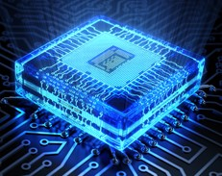
Design Workflow
Understanding the Algorithm and Math
Understanding the optimization Algorithm for Hardware Implementation
Implementing a small-size example
Design & implement top-level architecture
Design FSM of three sub-modules i.e. Key Generation, Encryption & Decryption
Implement basic operators i.e. add, sub, mul, division
Integration and Testing

Slide 32
Design Workflow
Understanding the Algorithm and Math
Understanding the optimization Algorithm for Hardware Implementation
Implementing a small-size example
Design & implement top-level architecture
Design FSM of three sub-modules i.e. Key Generation, Encryption & Decryption
Implement basic operators i.e. add, sub, mul, division
Integration and Testing

Slide 33
Presentation Flow
Motivation: why quantum-proof?
NIST: steps towards standardization
Design Workflow
State of the Art: main algorithm
What we are working on: tool-kit
Notes:
Let’s understand the algorithm

Slide 34



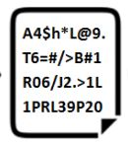
Ring-Learning with Error (R-LWE)
Public-Key Cryptosystem
Alice
Bob
TRNG
Key Generator
Module
Encryption Module
Gaussian Noise
Sampler
e
r0, r1, r2
Gaussian Noise
Sampler
Decryption Module
Notes:
RLWE based public-key cryptosystem has 3 major modules. First is key generator module. It takes care of generating the secret key or private key for Alice and also generates the second public key.

Slide 35
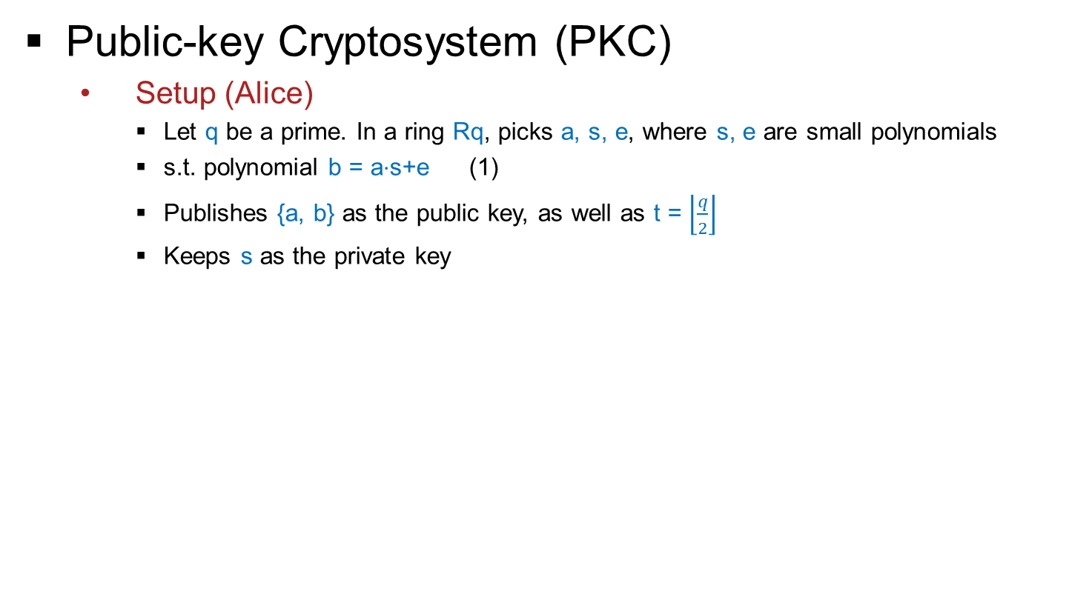
Ring-Learning with Error (Ring-LWE)
[1]
Public-key Cryptosystem (PKC)
Setup (Alice)
Let q be a prime. In a ring Rq, picks a, s, e, where s, e are small polynomials
s.t. polynomial b = a$⋅$s+e (1)
Publishes {a, b} as the public key, as well as t = $\left\lfloor \frac{q}{2}\right\rfloor$
Keeps s as the private key
[1] Oded Regev, “On lattices, learning with errors, random linear codes, and cryptography”, 2005

Slide 36
Ring-Learning with Error (Ring-LWE)
With e and without s, it is as hard as CVP in lattice crypto to find out if Eq (1) stands.
But with s, it is easy for Alice to verify Eq (1), making it a good trapdoor.
[1]
Public-key Cryptosystem (PKC)
Setup (Alice)
Let q be a prime. In a ring Rq, picks a, s, e, where s, e are small polynomials
s.t. polynomial b = a$⋅$s+e (1)
Publishes {a, b} as the public key, as well as t = $\left\lfloor \frac{q}{2}\right\rfloor$
Keeps s as the private key
[1] Oded Regev, “On lattices, learning with errors, random linear codes, and cryptography”, 2005
Notes:
Any asymmetric cryptosystem requires a good trapdoor, which means it is easy for legitimate users to verify but hard for adversaries to extract the secret. It is difficult for adversaries to see the existence of s with addition of small e.

Slide 37
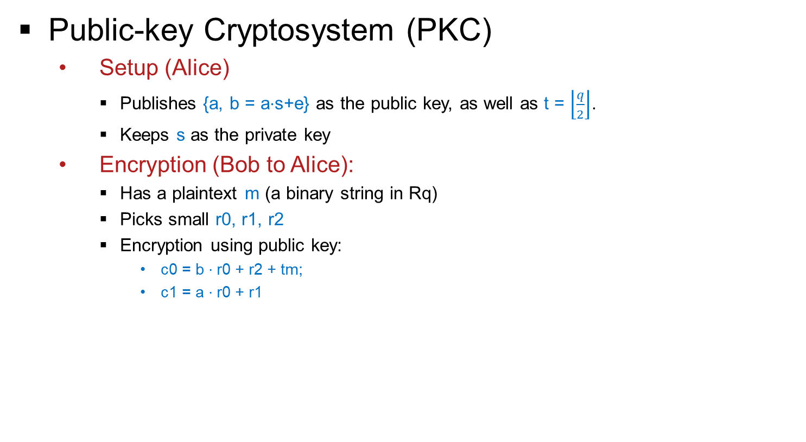
Ring-Learning with Error (Ring-LWE)
[1]
Public-key Cryptosystem (PKC)
Setup (Alice)
Publishes {a, b = a$⋅$s+e} as the public key, as well as t = $\left\lfloor \frac{q}{2}\right\rfloor$.
Keeps s as the private key
Encryption (Bob to Alice):
Has a plaintext m (a binary string in Rq)
Picks small r0, r1, r2
Encryption using public key:
c0 = b $⋅$r0 + r2 + tm;
c1 = a $⋅$r0 + r1
[1] Oded Regev, “On lattices, learning with errors, random linear codes, and cryptography”, 2005

Slide 38

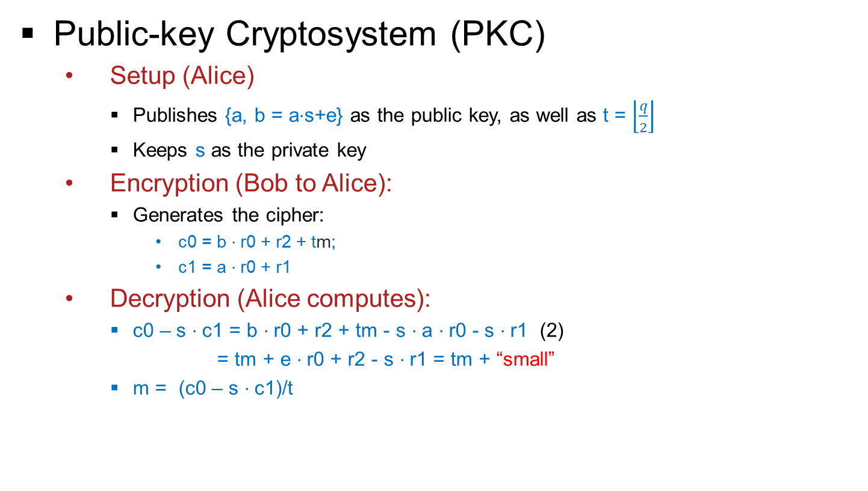
Ring-Learning with Error (Ring-LWE)
[1]
Public-key Cryptosystem (PKC)
Setup (Alice)
Publishes {a, b = a$⋅$s+e} as the public key, as well as t = $\left\lfloor \frac{q}{2}\right\rfloor$
Keeps s as the private key
Encryption (Bob to Alice):
Generates the cipher:
c0 = b $⋅$r0 + r2 + tm;
c1 = a $⋅$r0 + r1
Decryption (Alice computes):
c0 – s $⋅$c1 = b $⋅$r0 + r2 + tm - s $⋅$a $⋅$r0 - s $⋅$r1 (2)
= tm + e $⋅$r0 + r2 - s $⋅$r1 = tm + “small”
m = (c0 – s $⋅$c1)/t
e, r0, r1, r2 will be eliminated easily by Alice, but they make attacker’s life so much harder.
$$\left\lceil 1\right.\left.111q1111 \right\rfloor$$
Taking the nearest binary integer
[1] Oded Regev, “On lattices, learning with errors, random linear codes, and cryptography”, 2005
Notes:
Alice just needs to compute c0 – s.c1 and divide it by t to get the nearest binary integer. Alice knows s and she is capable of eliminating e, r0, r1. r2 easily but they make attackers life difficult.

Slide 39
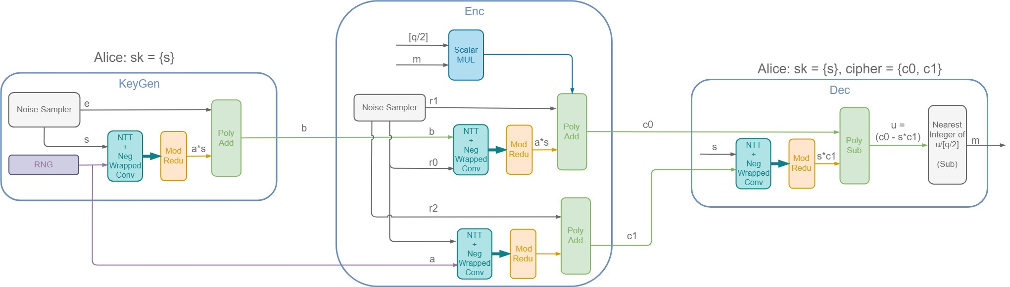
R-LWE Public Key Encryption Co-processor
[1]
Public-key Cryptosystem (PKC)
TRNG
Key Generator
Module
Encryption Module
Decryption Module
Gaussian Noise
Sampler
e
r0, r1, r2
Gaussian Noise
Sampler
[1] Oded Regev, “On lattices, learning with errors, random linear codes, and cryptography”, 2005

Slide 40
R-LWE Public Key Encryption Co-processor
Basic Operations
(Every operation is modular)
Random Number Generator
Gaussian Noise Sampler
Polynomial Addition/Subtraction
Scalar Multiplication with a Binary Polynomial
Scalar Division to the Nearest Binary Integer
Polynomial Multiplication
Size of the Polynomials/Vectors
Length: 256, 512, or 1024
Symbol: within the prime number 1,049,089

Slide 41
R-LWE Public Key Encryption Co-processor
Basic Operations
(Every operation is modular)
Random Number Generator ✓
Gaussian Noise Sampler ✓
Polynomial Addition/Subtraction ✓
Scalar Multiplication with a Binary Polynomial ✓
Scalar Division to the Nearest Binary Integer ✓
Can be done by 2 subtractions
Polynomial Multiplication hard
Size of the Polynomials/Vectors
Length: 256, 512, or 1024
Symbol: within the prime number 1,049,089
Notes:
We are dealing with large n and large prime numbers, so we have to be considerate about the hardware design.

Slide 42
Presentation Flow
Motivation: why quantum-proof?
NIST: steps towards standardization
Design Workflow
State of the Art: main algorithm
What we are working on: tool-kit
Hardware Cost-effective implementation
High-speed implementation

Slide 43
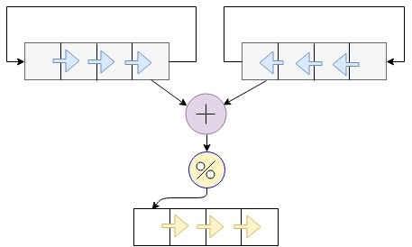
R-LWE Public Key Encryption Co-processor
Polynomial Addition
If x = [x0, x1, x2, x3], y = [y0, y1, y2, y3], then:
z = x + y = [(x0+y0)%q, (x1+y1)%q, (x2+y2)%q, (x3+y3)%q]
x3 x2 x1 x0
y0 y1 y2 y3
x0
y0
z0 = (x0 + y0) % q
z3 z2 z1 z0
Notes:
We discussed with Alan and he suggested two approaches. One approach could have been BRAM-based and the other approach is register based as shown here. One important thing to note is that, even addition and mod can be expensive when the operands are over 20 bits. For example, the mod itself takes up 500 LUTs.

Slide 44
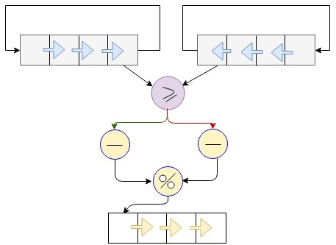
R-LWE Public Key Encryption Co-processor
Polynomial Subtraction
If x = [x0, x1, x2, x3], y = [y0, y1, y2, y3], then: z = x – y
z0 = (x0 – y0)%q = (x0 >= y0) ? (x0-y0) : (q – (y0 – x0))
x3 x2 x1 x0
y0 y1 y2 y3
x0
y0
x0 - y0
q - y0 + x0
z0 = (x0 - y0) % q
z3 z2 z1 z0
Notes:
Vector subtraction is still a component-wise operation. However, due to the mod nature, there is no negative result

Slide 45
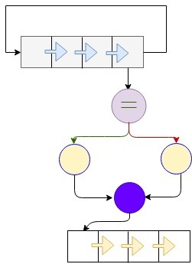
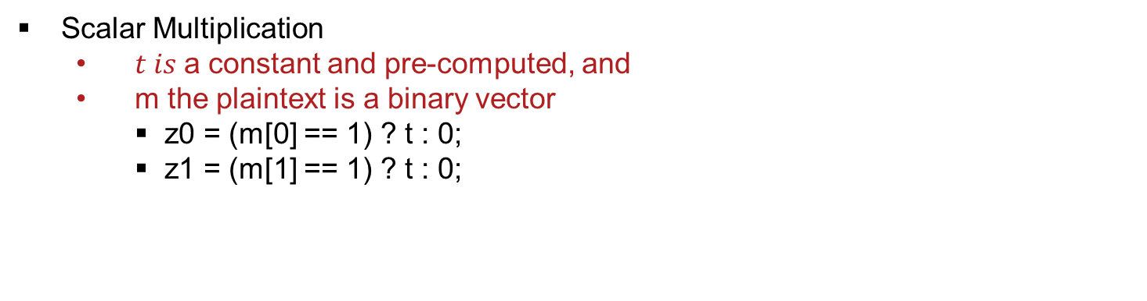
R-LWE Public Key Encryption Co-processor
Scalar Multiplication
$t is$a constant and pre-computed, and
m the plaintext is a binary vector
z0 = (m[0] == 1) ? t : 0;
z1 = (m[1] == 1) ? t : 0;
m3 m2 m1 m0
1
t
0
z = mt
z3 z2 z1 z0
Notes:
The scalar mul is with a constant and a binary vector, so it can be done with just conditional assignments, without using mul.

Slide 46
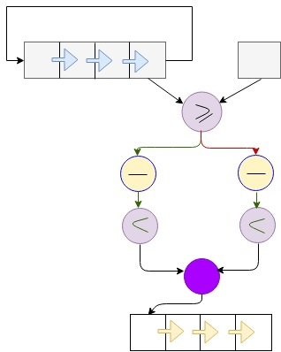
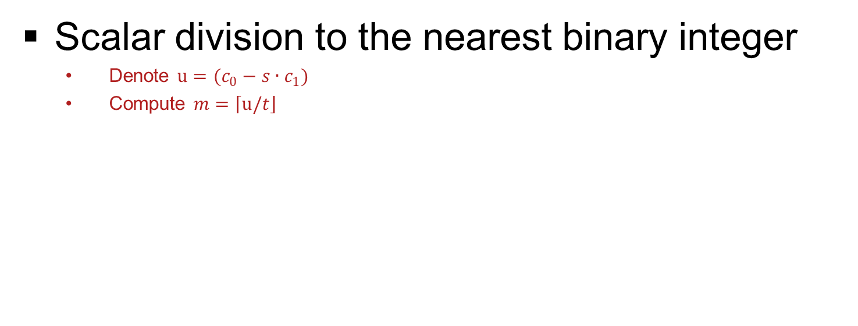
R-LWE Public Key Encryption Co-processor
Scalar division to the nearest binary integer
Denote $u=(c_{0}−s∙c_{1})$
Compute $m=\left\lceil u/\right.\left.t\right\rfloor$
u3 u2 u1 u0
t
u0
u0 - t
t - u0
(u0 – t) < t/2
(t - u0) < t/2
1/0
m3 m2 m1 m0
Notes:
We need this operation during decryption. u can be computed by the vector multiplication and subtraction modules.
Actually, we can use a trick to compute this equation without involving any division. Absolute (u – t) measures the distance between u and t. If this distance is larger than half of t, meaning it is too far, then the nearest integer of the quotient (u/t) should be 0. If the distance is within half of t, then the nearest integer of the quotient (u/t) should be 1.
For example:
when q = 17, then t = 8, t/2 = 4
If u = [2, 9], then $m=\left\lceil u/\right.\left.t\right\rfloor$ = [0, 1]
If u = [7, 15], then $m=\left\lceil u/\right.\left.t\right\rfloor$ = [1, 0]

Slide 47
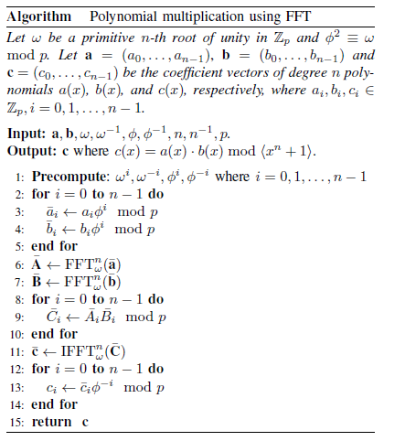
R-LWE Public Key Encryption Co-processor
Modular Polynomial Multiplication
Naïve Convolution Then Polynomial Reduction
By FFT over finite field
Negative Wrapped Convolution (NWC)
Fast Number Theoretic Transform (NTT)
Component-wise multiplication
Inverse NTT
Inverse NWC
Notes:
Convolution Theorem states that convolution in one domain equals point-wise multiplication in the other domain. It reduces complexity from N^2 to NlogN
We need neg wrapped conv. So that we don’t need to extend the length of vector before performing NTT which in turn helps in avoiding polynomial reduction. Then we perform transformation of both the multiplicands using NTT. Next step is component wise multiplication. Then transformed back using NTT, then perform inverse neg wrapped conv. So component wise multiplication is basically a sandwich between convolution and transformation operations.

Slide 48
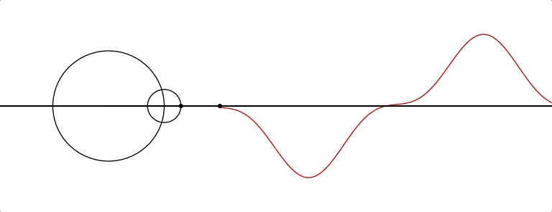
R-LWE Public Key Encryption Co-processor
NTT – the number-theoretic transform
The FFT over finite field

Slide 49
Post-Quantum Cryptography (PQC) Standardization (Round -2)
 | Public-Key Encryption
 | Lattice-based/Ring-LWE |  | Code-based |  | Other
1 | NTRU Prime | (R-lattice) | Classic McEliece | (Binary Goppa)
2 | NTRU European Encryption Standard | (R-lattice) | HQC | (BCH & cyclic)
3 | LAC | (R-LWE) | RQC | (cyclic)
4 | SABER | (Mod-LWR) | LEDA | (LDPC)
5 | Round5 | (R-LWR) | ROLLO (LAKE & LOCKER) | (LRPC)
 | Digital Signature
 | Lattice-based/Ring-LWE
1 | FALCON | (NTRU R-lattice)
2 | qTESLA | (R-LWE)
3 | CRYSTALS-DILITHIUM | (R-LWE)
 | Key Establishment/Encapsulation
 | Lattice-based/Ring-LWE |  | Code-based |  | Other
1 | NewHope | (R-LWE) | BIKE | (MDPC) | SIKE (Isogeny)
2 | NTRU European Encryption Standard | (R-lattice) | NTS-KEM | (Binary Goppa)
3 | FrodoKEM | (R-LWE) | LEDA | (LDPC)
4 | CRYSTALS-KYBER | (R-LWE) | ROLLO (LAKE & LOCKER) | (LRPC)
5 | SABER | (Mod-LWR)
6 | Three Bears | (Mod-LWE)
Notes:
While the RLWE algorithms may have different name, they still follow a similar scheme for encryption and decryption. We are working on designing a standard algorithm. So whoever wins, we can tweak the design accordingly and switch to new algorithm easily.

Slide 50
R-LWE Public Key Encryption Co-processor
Our Design Goals
Low hardware cost
Want to fit everything on one FPGA
1 DSP multiplier, 1 adder, 1 subtractor, 1 mod reductor
Latency (trade-off)
Estimated: 34,816 cycles, 35 milliseconds

Slide 51
R-LWE Public Key Encryption Co-processor
Our Design Goals
Low hardware cost
Want to fit everything on one FPGA
1 DSP multiplier, 1 adder, 1 subtractor, 1 mod reductor
Latency (trade-off)
Estimated: 34,816 cycles, 35 milliseconds
The Cost
~ 0.00035 seconds

Slide 52
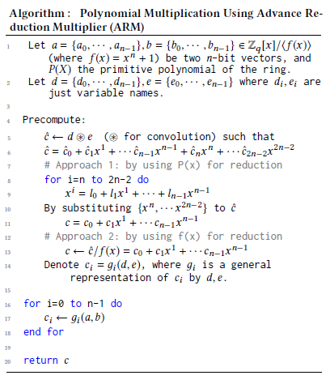
1 Clock-cycle Decryption (if we are rich)
Advance Reduction Multiplier (ARM)
In advance: compute the general representation of the product
In advance: computing the primitive/irreducible polynomial reduction
Compute the general representation of the product (2n symbols)
Reduce the product with primitive polynomial (n symbols)
Acquire the general representation of each symbol
Substitute the multiplicands to get the product
Notes:
This is just a future work. The primitive polynomial is a special existence over finite fields, which reveals how a field can be generated, and the connection among the power of primitive roots of the fields. As you can see, most of the work, especially the primitive polynomial assisted reduction, is done in advance. And we only have to do it once in a lifetime. That is why it is called advance reduction multiplier. At real time, the only thing we need to do is substituting the actual values of the multiplicands, to get the product in one step.

Slide 53

Any Questions?

